Slide 1


IELTs EXAMINATion
Notes:
NOTE:
To change the image on this slide, select the picture and delete it. Then click the Pictures icon in the placeholder to insert your own image.

Slide 2

STUDY OR WORK ABROAD?
IELTS???
Notes:
Do you want to study abroad, work overseas, or immigrate—but the moment you hear IELTS, you feel confused? Many people study IELTS for years but still don’t really understand what they are taking or why their score never improves.” “In this video, I’ll help you clearly understand what IELTS really is, and why learning the right way from the beginning matters more than studying for a long time.”
“Hello, my name is April Ampong, and I’m an instructor at IELTS NINER REVIEW CENTER— an international-standard IELTS training system that helps learners progress from beginner level to Band 7.0–9.0 in the most time-efficient way.” “This entire video series is designed in short, focused 5–7 minute lessons, targeting exactly what IELTS examiners assess.”

Slide 3
Coverage
What Is IELTS?
Who Needs IELTS?
Common Misunderstandings About IELTS
Our Teaching Approach- IELTS 9.0

Slide 4
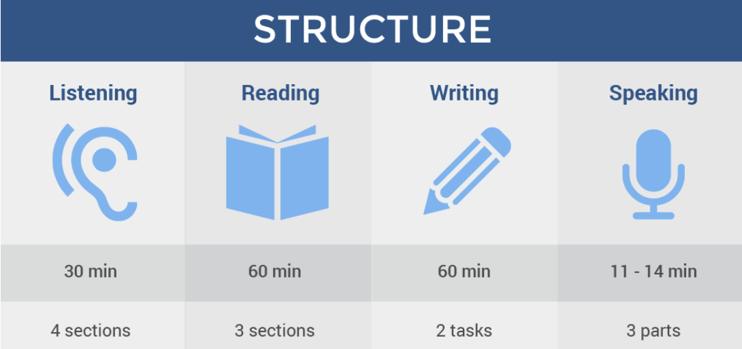
What Is IELTS?
IELTS stands for International English Language Testing System— an exam that measures your ability to use English in real-life situations, not test tricks or memorization
IELTS does not test
how many words you know, but how effectively you use English.
4 SKILLS
Notes:
“IELTS, or the International English Language Testing System, is a globally recognized English proficiency test. It measures a person’s ability to use English in four key skills: listening, reading, writing, and speaking. IELTS is commonly required for study, work, and migration in English-speaking countries such as the UK, Canada, Australia, and New Zealand.”

Slide 5

Who Needs IELTS?
Study for a bachelor’s, master’s, or PhD degree
Apply for a visa or immigration
Notes:
“IELTS is required by individuals who plan to study abroad, apply for overseas employment, or migrate to an English-speaking country. It is also needed by professionals such as teachers, nurses, and other skilled workers whose licenses require proof of English proficiency. In short, anyone who needs to demonstrate their English ability for international purposes may need IELTS.”

Slide 6

Common Misunderstandings About IELTS
Believing you must sound like a native speaker
Assuming more materials mean better results
Thinking IELTS is a general English test
IELTS is a criteria-based exam with very clear marking standards. Those who understand the criteria always have an advantage
Notes:
“There are many misconceptions about IELTS. One common misunderstanding is that IELTS is only for native English speakers, when in fact it is designed for non-native speakers. Another myth is that IELTS is extremely difficult, when success actually depends on proper training, strategy, and practice. IELTS does not test intelligence—it tests how effectively you can communicate in English.”

Slide 7
Our Teaching Approach
Every lesson answers three essential questions:
What do examiners actually mark?
Why do candidates lose points?
How can you increase your band score in the shortest time?
“
Notes:
“Our teaching approach is focused on helping students achieve their best possible band score, even up to IELTS 9.0. We emphasize clear strategies, real exam practice, and personalized feedback for each skill area. Rather than memorization, we focus on confidence-building, accuracy, and real-life communication—ensuring students are fully prepared for the IELTS exam.”

Slide 8
IELTS Academic or
IELTS General Training?
Notes:
“But understanding what IELTS is—that’s not enough.” “In the next video, I’ll help you answer the most important question of all: Should you take IELTS Academic or IELTS General Training? Choose the wrong one, and you could waste 6–12 months starting over.” “See you in the next video.”

